Slide 1
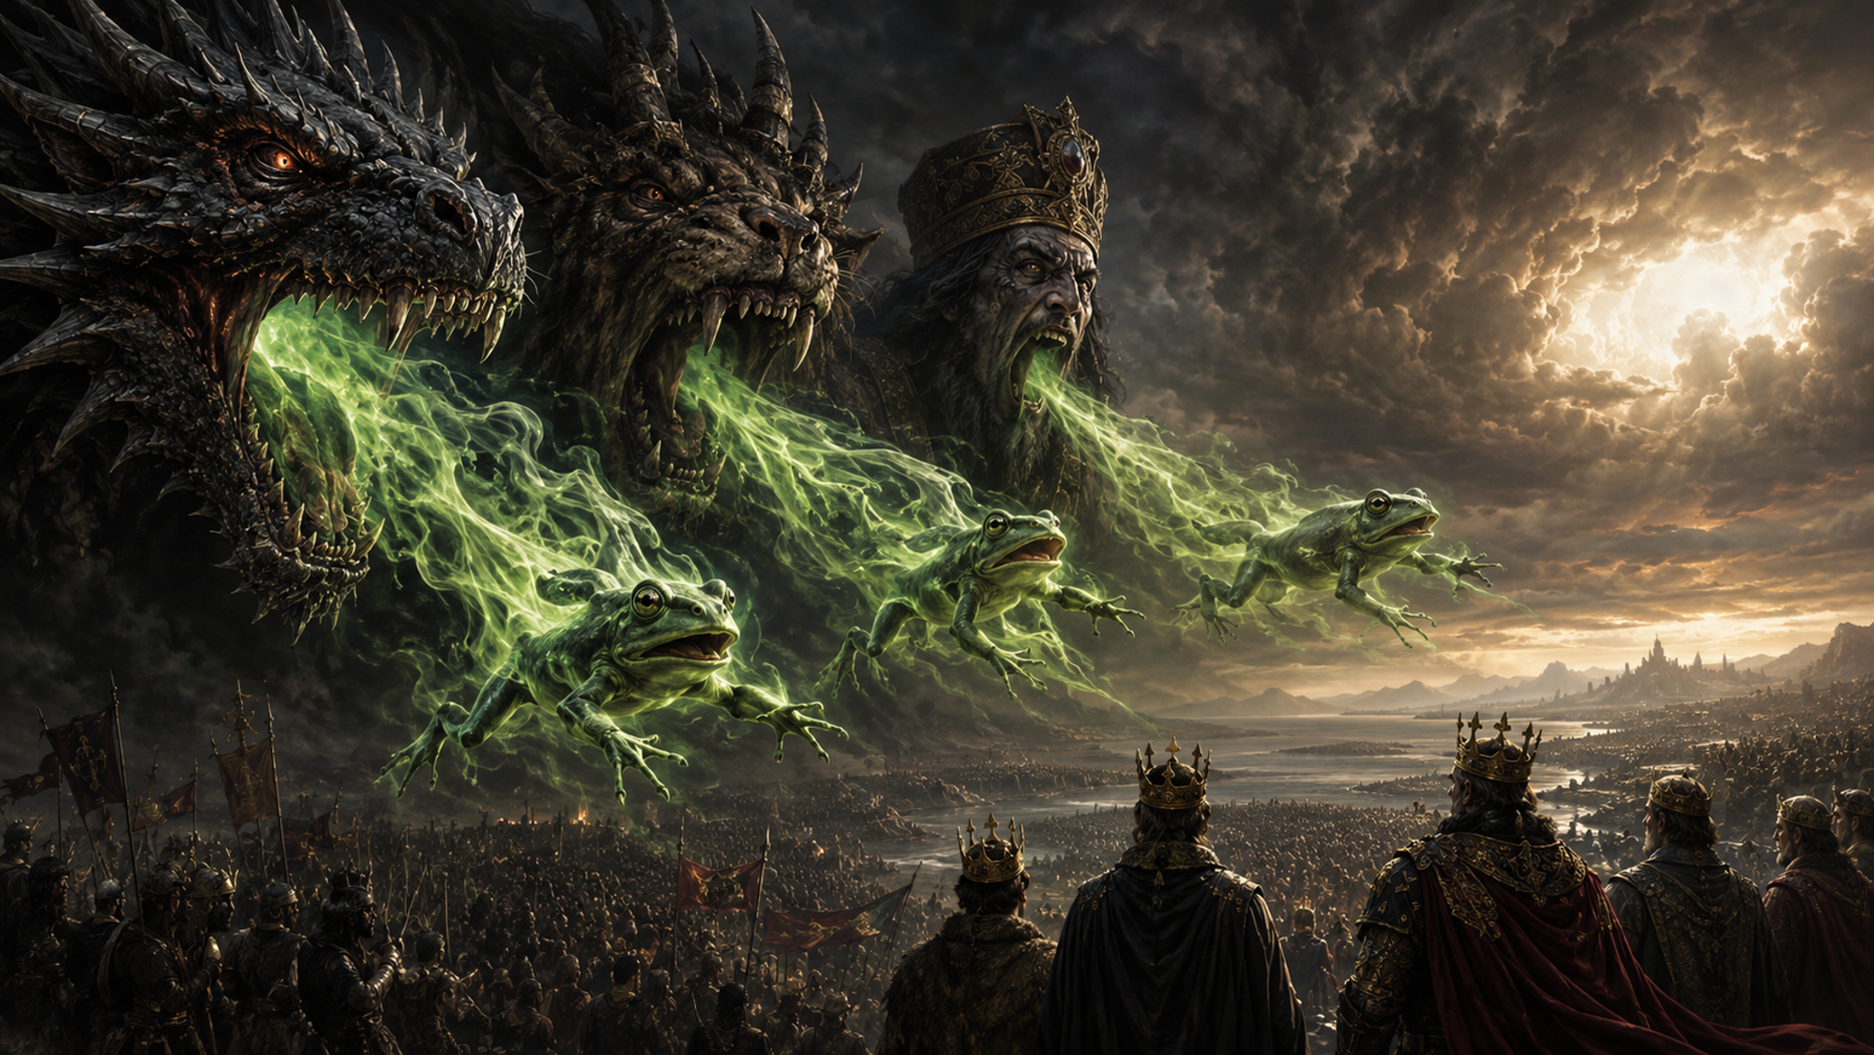
Is Armageddon Imminent?

Slide 2
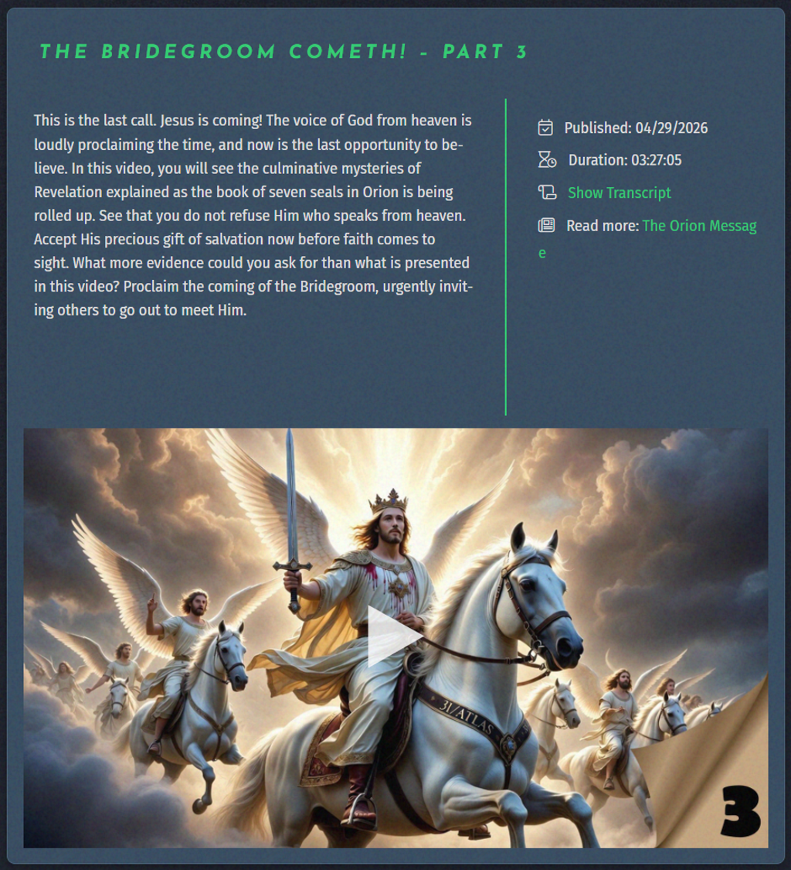
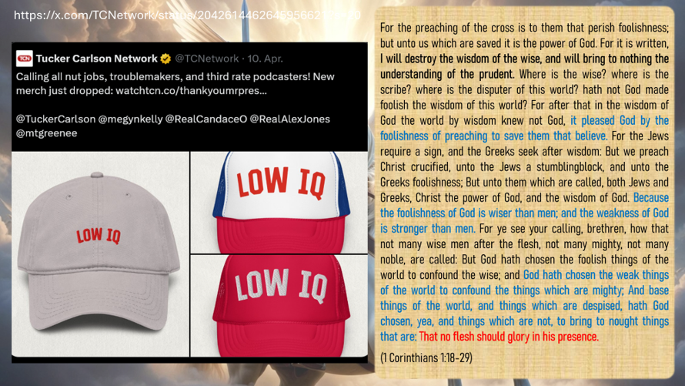


Slide 3

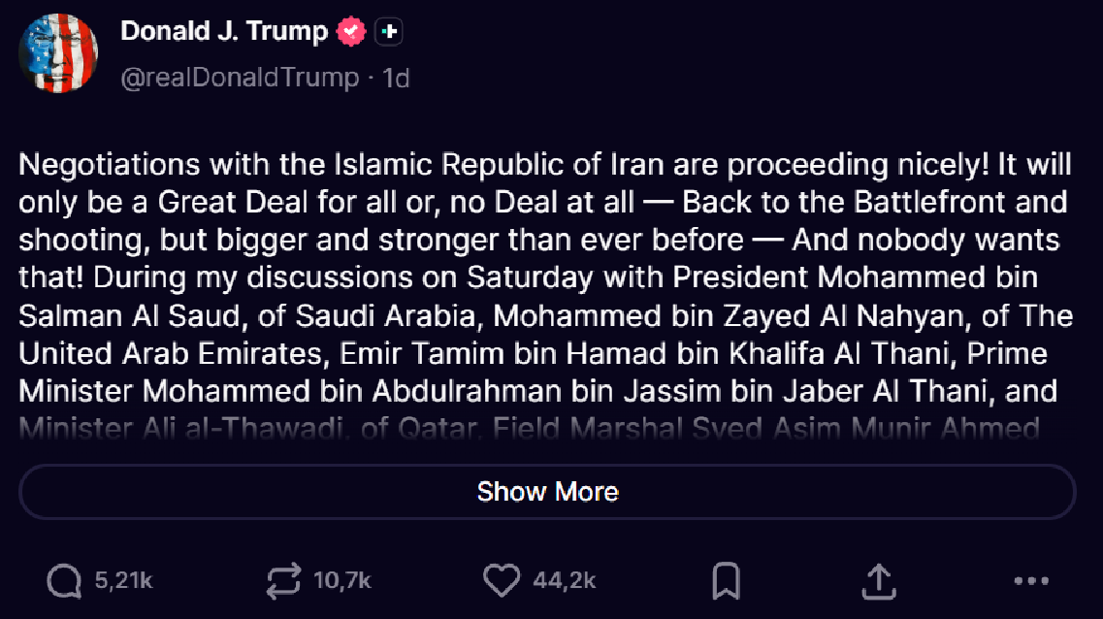
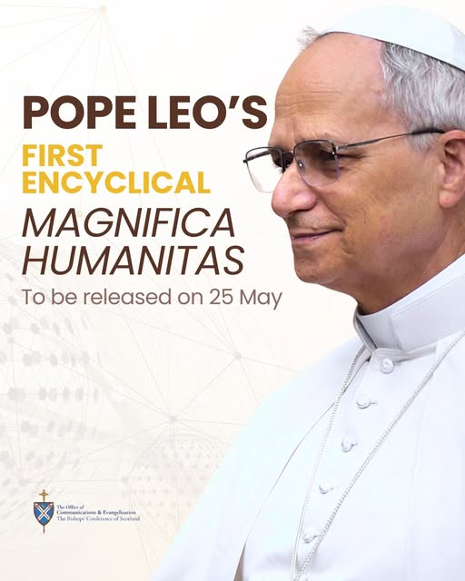
Negotiations with the Islamic Republic of Iran are proceeding nicely! It will only be a Great Deal for all or, no Deal at all — Back to the Battlefront and shooting, but bigger and stronger than ever before — And nobody wants that!
During my discussions on Saturday with President Mohammed bin Salman Al Saud, of Saudi Arabia, Mohammed bin Zayed Al Nahyan, of The United Arab Emirates, Emir Tamim bin Hamad bin Khalifa Al Thani, Prime Minister Mohammed bin Abdulrahman bin Jassim bin Jaber Al Thani, and Minister Ali al-Thawadi, of Qatar, Field Marshal Syed Asim Munir Ahmed Shah, of Pakistan, President Recep Tayyip Erdoğan, of Türkiye, President Abdel Fattah El-Sisi, of Egypt, King Abdullah II, of Jordan, and King Hamad bin Isa Al Khalifa, of Bahrain, I stated that, after all the work done by the United States to try and pull this very complex puzzle together, it should be mandatory that all of these Countries, at a minimum, simultaneously, sign onto the Abraham Accords.
Those Countries discussed are Saudi Arabia, The United Arab Emirates (already a Member!), Qatar, Pakistan, Türkiye, Egypt, Jordan, and Bahrain (already a Member!). It may be possible that one or two have a reason for not doing so, and that will be accepted, but most should be ready, willing, and able to make this Settlement with Iran a far more Historic Event than it would, otherwise, be.
The Abraham Accords have proven to be, for the Countries involved (The United Arab Emirates, Bahrain, Morocco, Sudan, and Kazakhstan), a Financial, Economic, and Social BOOM, even during this time of Conflict and War, with the current Members never even suggesting leaving, or taking so much as even a pause.
The reason for this is that the Abraham Accords have been great for them, and will be even better for everybody, and bring true Power, Strength, and Peace to the Middle East for the first time in 5,000 years. It will be a Document respected like no other that has ever been signed, anywhere in the World. Its level of Importance and Prestige will be unparalleled!
It should start with the immediate signing by Saudi Arabia and Qatar, and everybody else should follow suit. If they don’t, they should not be part of this Deal in that it shows bad intention.
In speaking to numerous of the Great Leaders mentioned above, they would be honored, as soon as our Document is signed, to have the Islamic Republic of Iran as part of the Abraham Accords. Wow, now that would be something special!
This will be the most important Deal that any of these Great, but always in Conflict Countries, will ever sign. Nothing in the past, or in the future, will surpass it.
Therefore, I am mandatorily requesting that all Countries immediately sign the Abraham Accords, and that, if Iran signs its Agreement with me, as President of the United States of America, it would be an Honor to have them also be part of this unparalleled World Coalition.
The Middle East would be United, Powerful, and Economically Strong, like perhaps no other area, anywhere in the World!
By copy of this TRUTH, I am asking my Representatives to begin, and successfully complete, the process of signing these Countries into the already Historic Abraham Accords.
Thank you for your attention to this matter!
DONALD J. TRUMP
PRESIDENT OF THE UNITED STATES OF AMERICA
https://truthsocial.com/@realDonaldTrump/116635193825443617

Slide 4

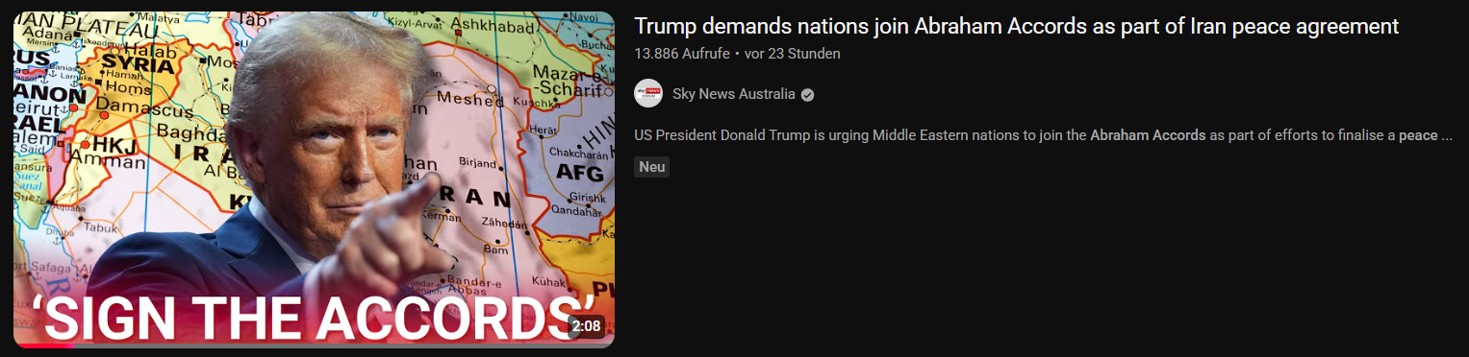
The Enriched Uranium (Nuclear Dust!) will either be immediately turned over to the United States to be brought home and destroyed or, preferably, in conjunction and coordination with the Islamic Republic of Iran, destroyed in place or, at another acceptable location, with the Atomic Energy Commission, or its equivalent, being witness to this process and event.
Thank you for your attention to this matter!
President DJT
https://truthsocial.com/@realDonaldTrump/116637404995923093
https://www.youtube.com/live/h9lYVcVmABg
https://www.youtube.com/watch?v=PhNSmJZitVc&

Slide 5
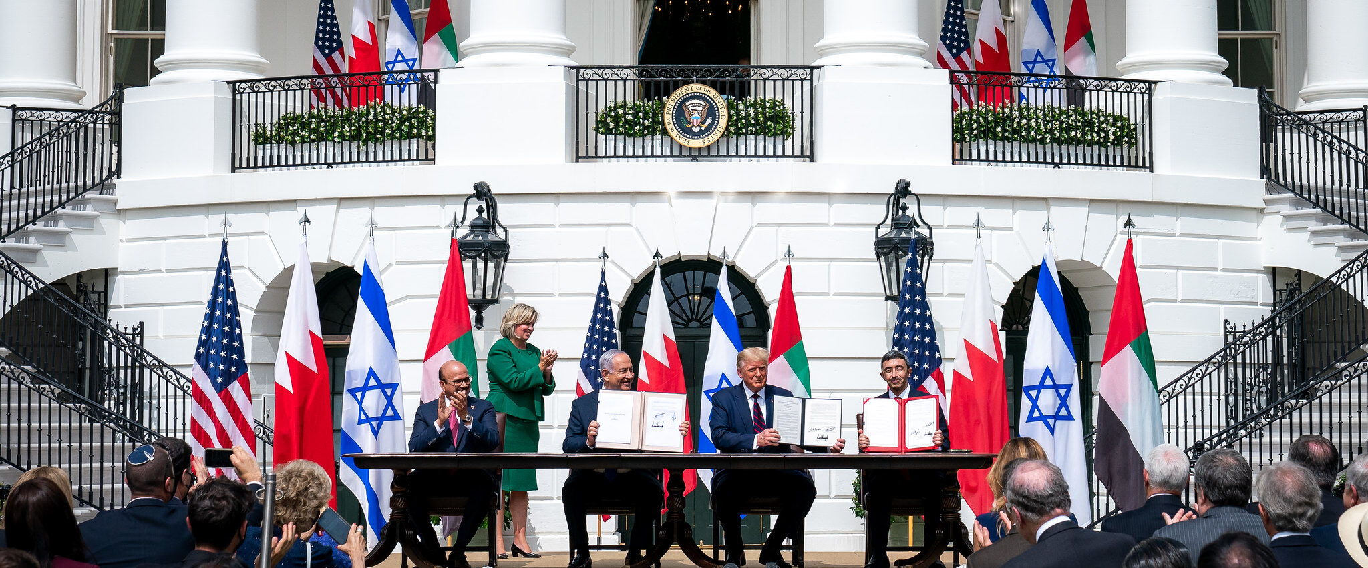
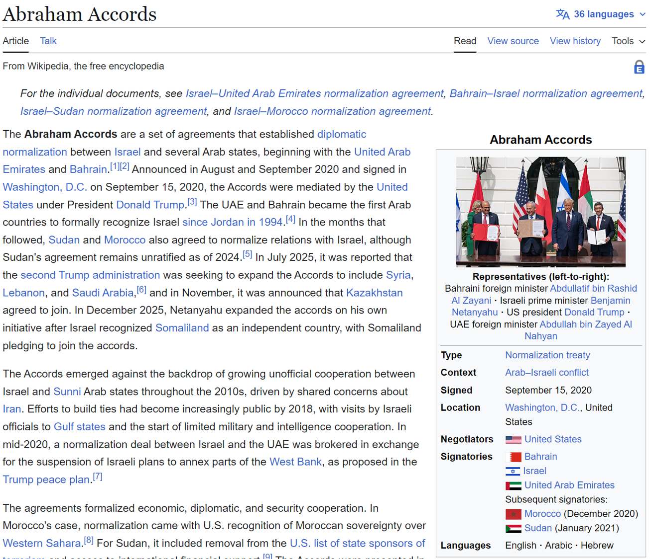
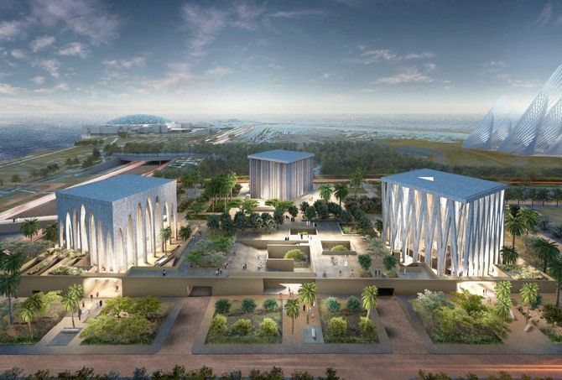
https://en.wikipedia.org/wiki/Abraham_Accords
The Abrahamic Family House (with its three houses of worship) is a flagship symbolic project of the Abraham Accords.
The Abraham Accords represent normalization, peace, and coexistence between Israel (Judaism) and Arab countries (Islam) — without the old conflict acting as a barrier. The Abrahamic Family House embodies exactly this spirit: a mosque, a church, and a synagogue standing side by side as a sign of Abrahamic brotherhood and interreligious dialogue. Although it was already planned in 2019 (following Pope Francis’s visit), it was strongly promoted after the Abraham Accords (2020) and officially opened in 2023. Many see it as the practical implementation of the Accords’ vision of tolerance and coexistence.

Slide 6
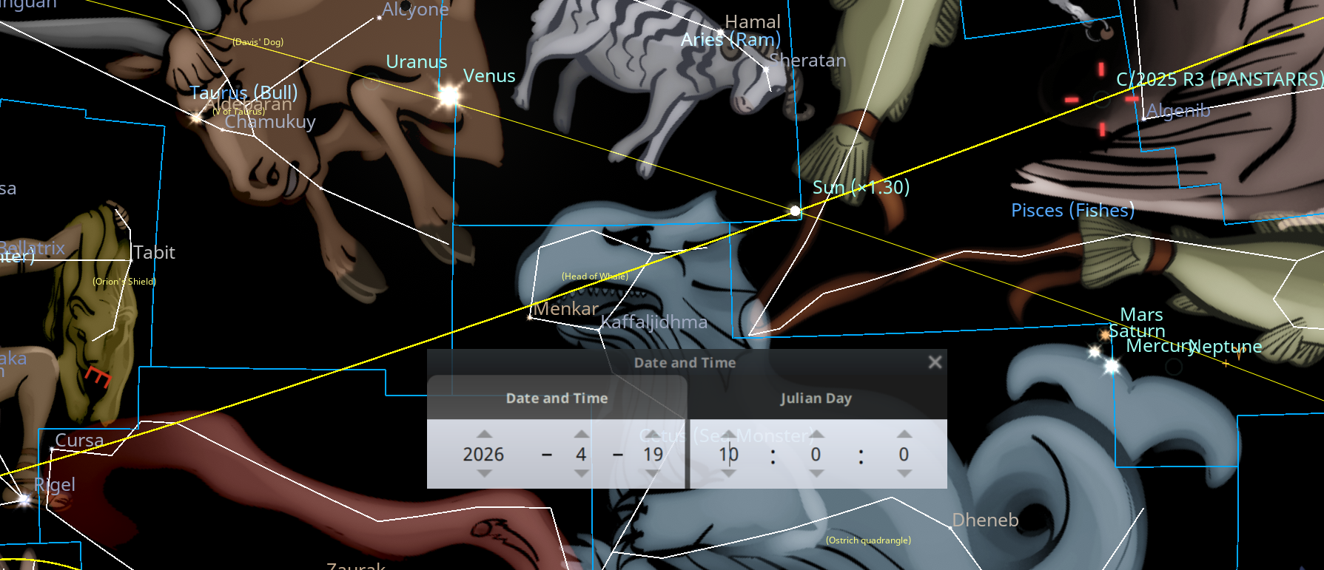
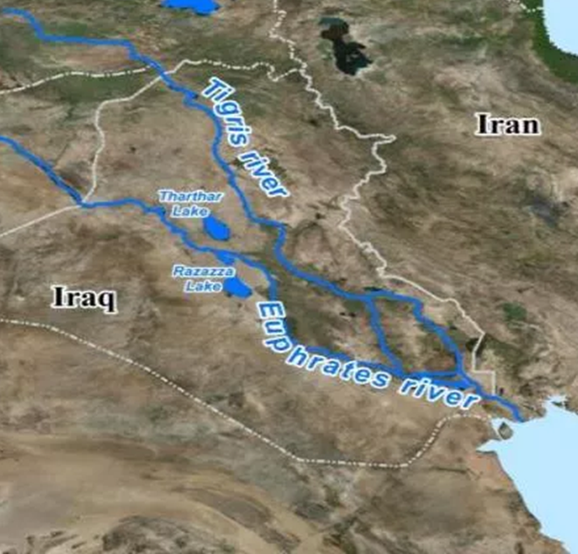

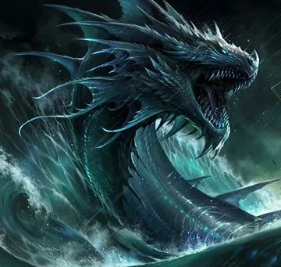
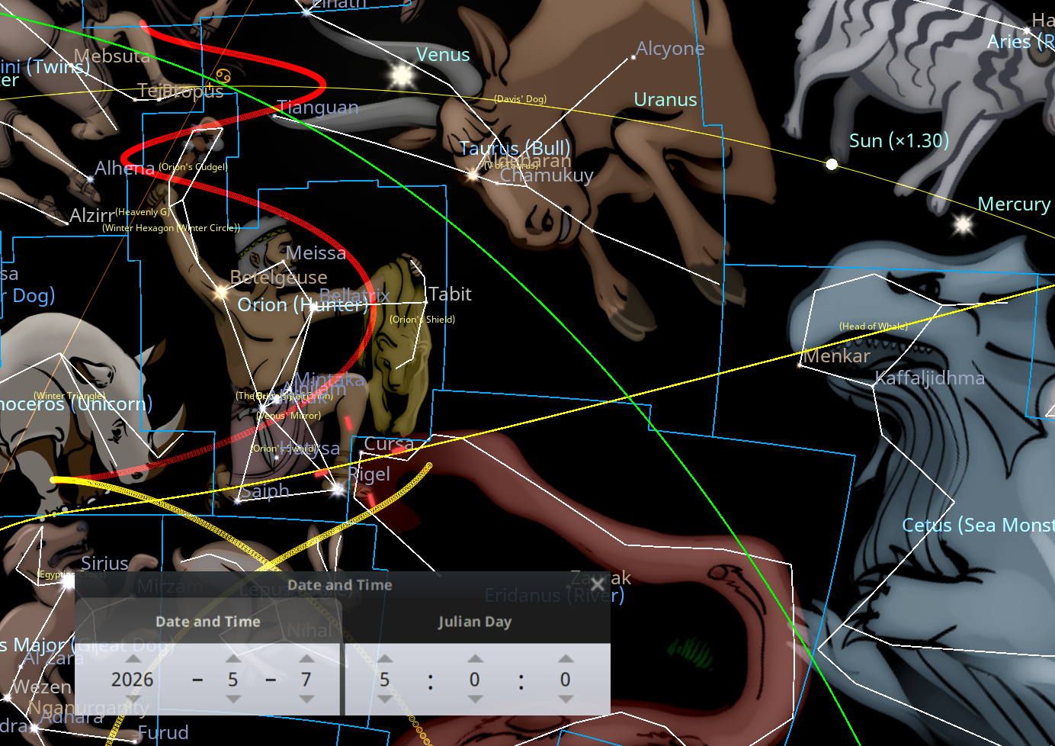
6
C/2024 E1
Last chance! Watch and keep your garment!
C/2025 R3
Eridanus dry
And the sixth angel poured out his vial upon the great river Euphrates; and the water thereof was dried up, that the way of the kings of the east might be prepared. And I saw three unclean spirits like frogs come out of the mouth of the dragon, and out of the mouth of the beast, and out of the mouth of the false prophet. For they are the spirits of devils, working miracles, which go forth unto the kings of the earth and of the whole world, to gather them to the battle of that great day of God Almighty. Behold, I come as a thief. Blessed is he that watcheth, and keepeth his garments, lest he walk naked, and they see his shame. And he gathered them together into a place called in the Hebrew tongue Armageddon. (Revelation 16:12-16)

Slide 7
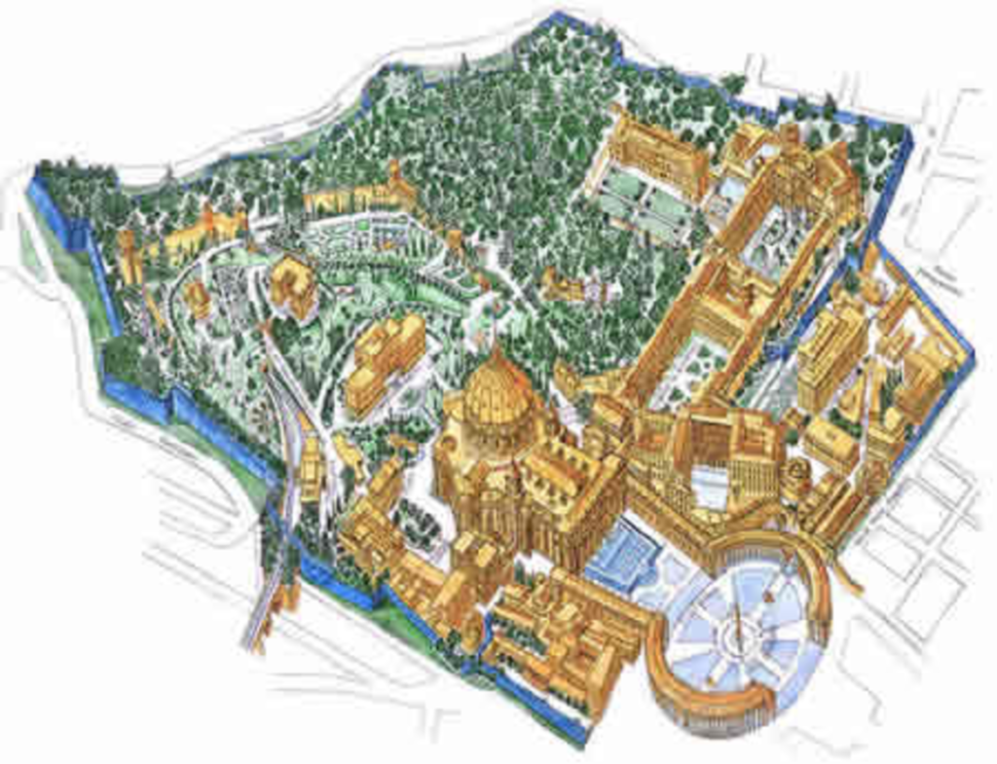
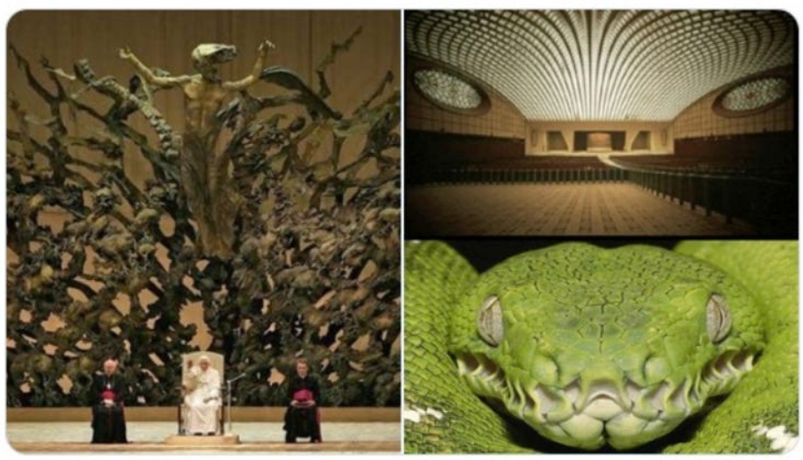
And I saw three unclean spirits like frogs come out of the mouth of the dragon, and out of the mouth of the beast, and out of the mouth of the false prophet. (Revelation 16:13)

Slide 8
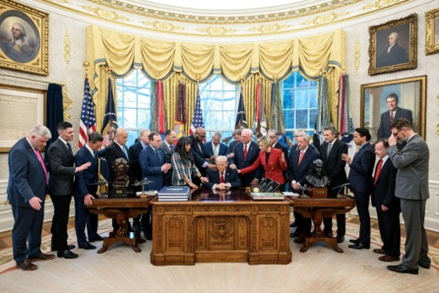
And I saw three unclean spirits like frogs come out of the mouth of the dragon, and out of the mouth of the beast, and out of the mouth of the false prophet. (Revelation 16:13)

Slide 9
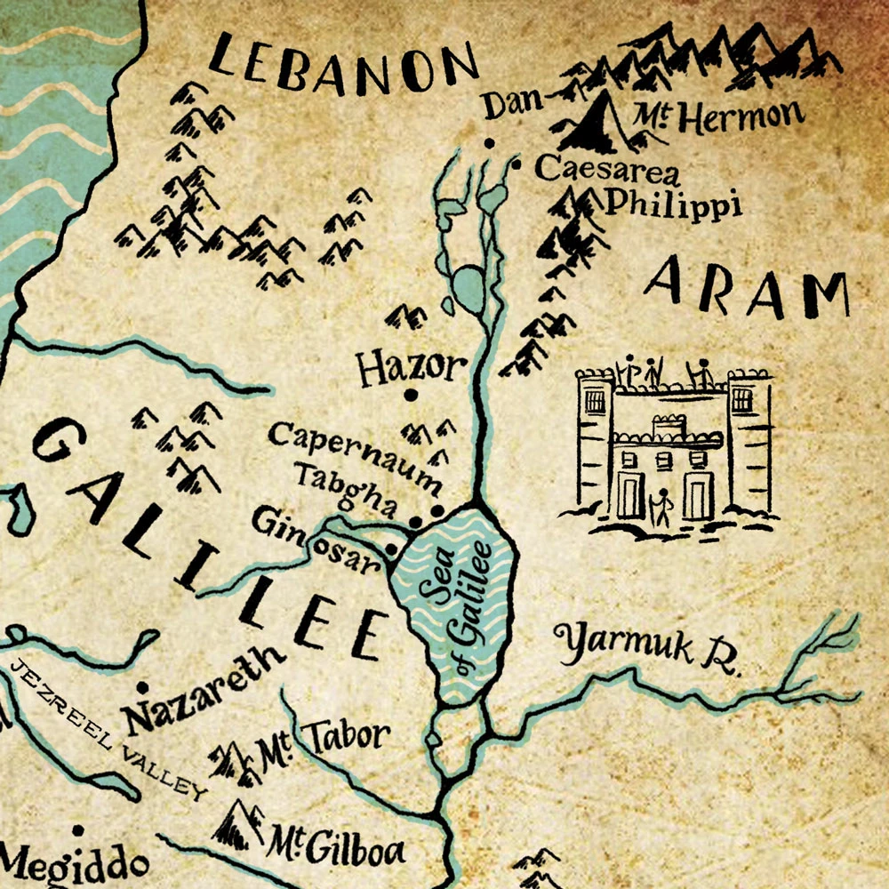
And I saw three unclean spirits like frogs come out of the mouth of the dragon, and out of the mouth of the beast, and out of the mouth of the false prophet. (Revelation 16:13)

Slide 10
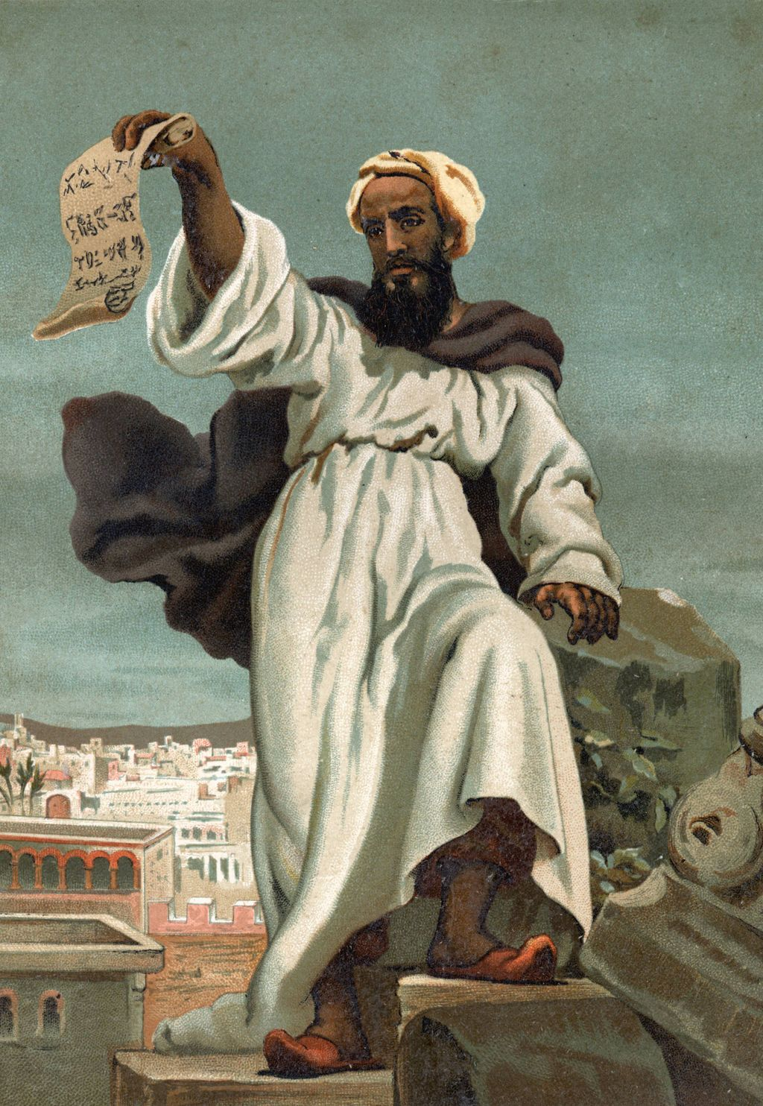
G3625 οἰκουμένη oikoumene (oi-kou-me'-nee) n.
1. land, i.e. the (earthly part of the) globe.
2. (specially) the Roman empire.
[feminine participle present passive of G3611 (as noun, by implication, of G1093)]
KJV: earth, world
Root(s): G3611
See also: G1093

Slide 11
Behold, I come as a thief. Blessed is he that watcheth, and keepeth his garments, lest he walk naked, and they see his shame. And he gathered them together into a place called in the Hebrew tongue Armageddon. (Revelation 16:15-16)
H7650 שָׁבַע shaba` (shaw-ɓah') v.
1. (properly) to be complete (but used only as a denominative from H7651).
2. to seven oneself, i.e. to completely swear (as if by repeating a declaration seven times).
[a primitive root]
KJV: adjure, charge (by an oath, with an oath), feed to the full (by mistake for H7646), take an oath, X straitly, (cause to, make to) swear.
Compare: H7651
See also: H7646

Slide 12
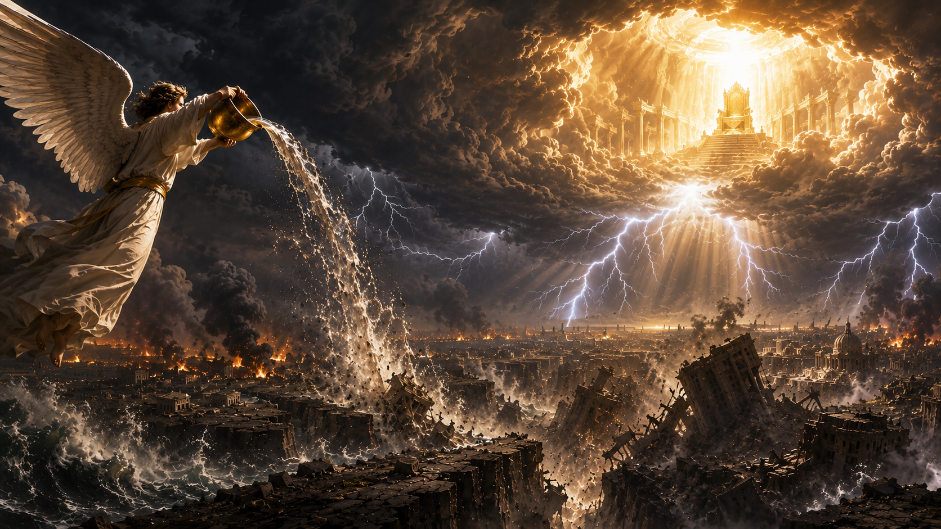
And the seventh angel poured out his vial into the air; and there came a great voice out of the temple of heaven, from the throne, saying, It is done. And there were voices, and thunders, and lightnings; and there was a great earthquake, such as was not since men were upon the earth, so mighty an earthquake, and so great. (Revelation 16:17-18)

Slide 13
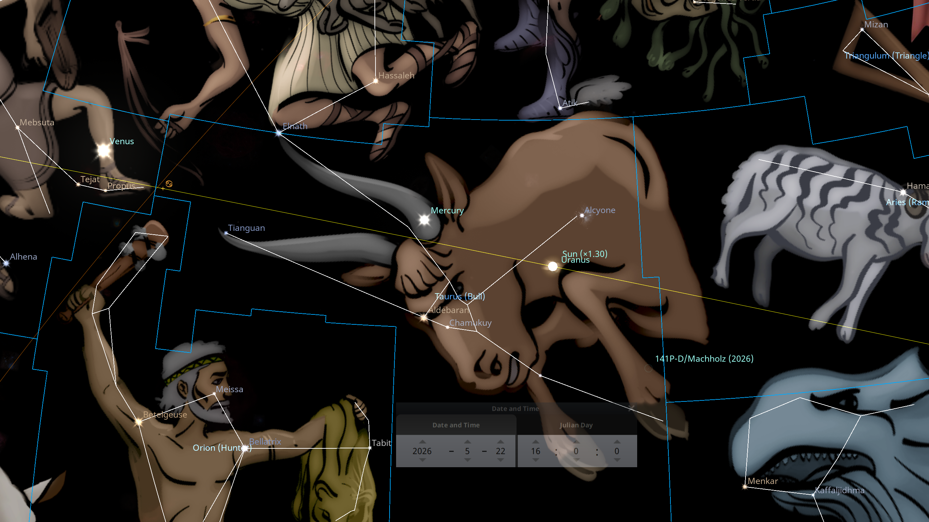
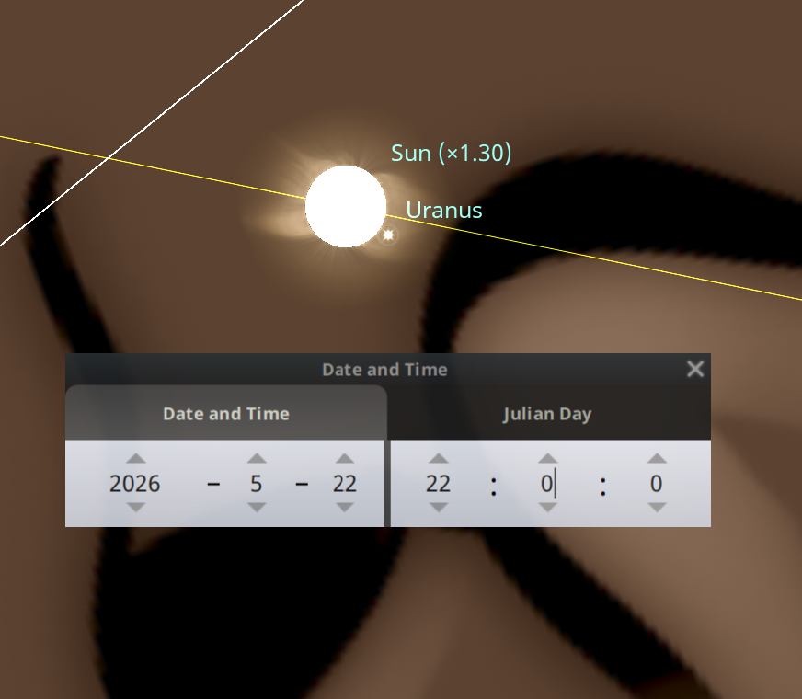
And the seventh angel poured out his vial into the air; and there came a great voice out of the temple of heaven, from the throne, saying, It is done. And there were voices, and thunders, and lightnings; and there was a great earthquake, such as was not since men were upon the earth, so mighty an earthquake, and so great. (Revelation 16:17-18)

Slide 14
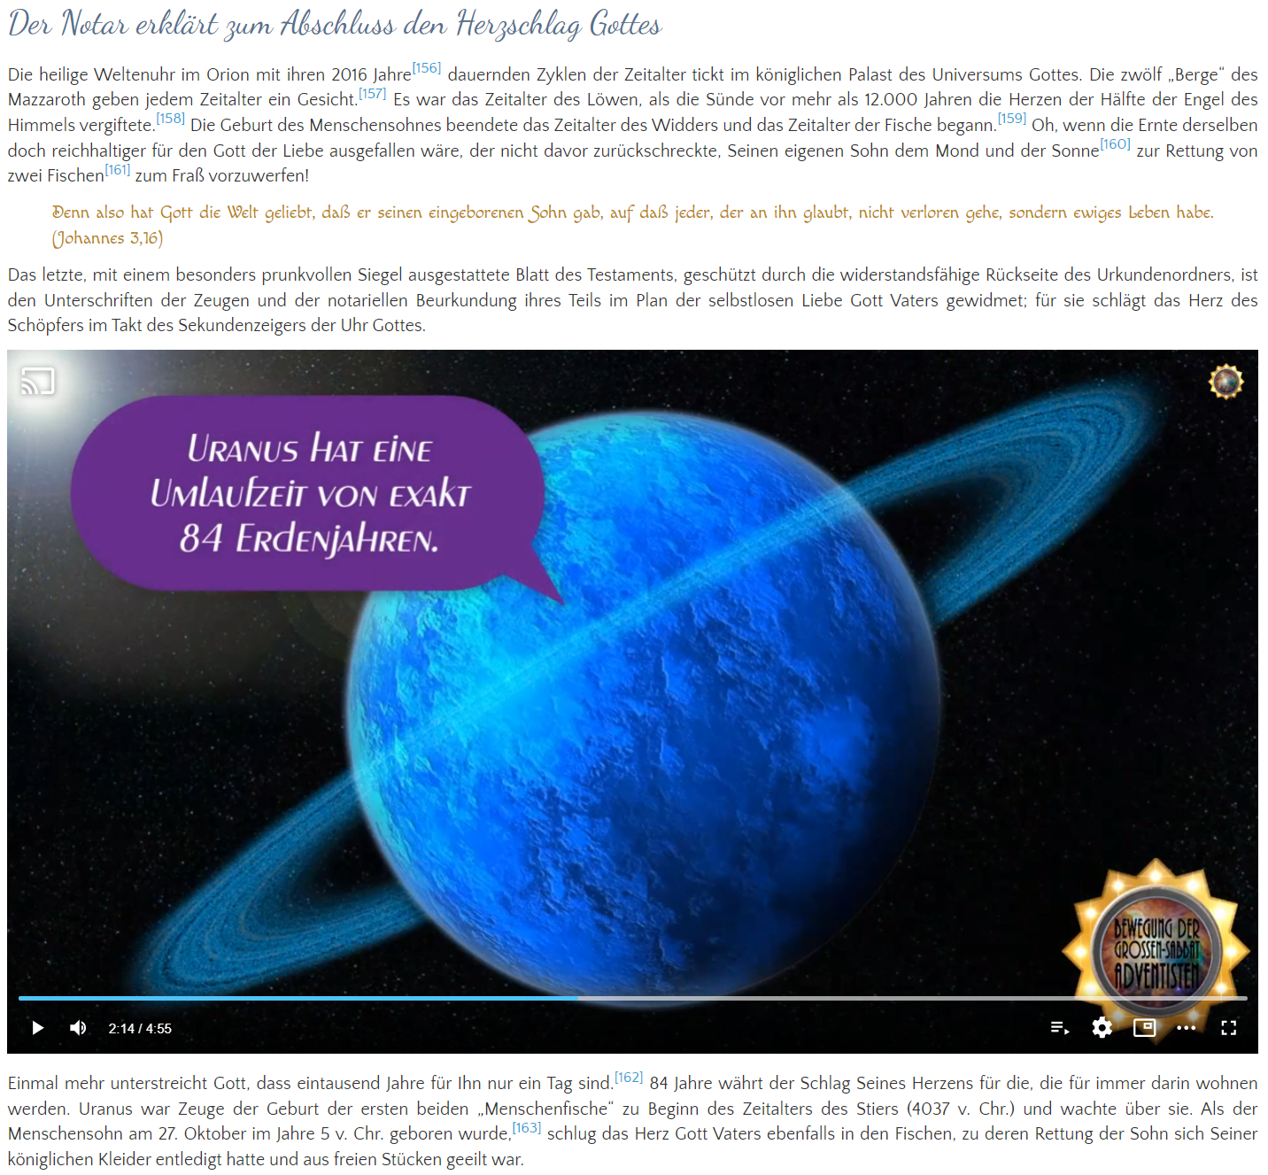
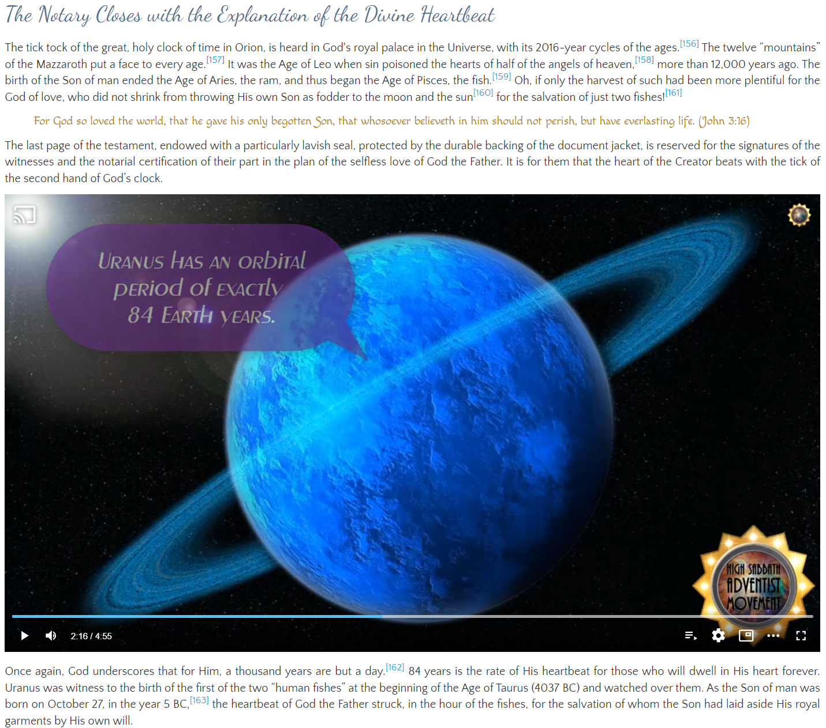



Slide 15

And the seventh angel poured out his vial into the air; and there came a great voice out of the temple of heaven, from the throne, saying, It is done. And there were voices, and thunders, and lightnings; and there was a great earthquake, such as was not since men were upon the earth, so mighty an earthquake, and so great. (Revelation 16:17-18)
Uranus is a gas giant (more precisely: an ice giant) with a thick, extensive atmosphere. Its composition consists of about 83% hydrogen, 15% helium, and 2.3% methane (plus traces of other gases). The planet itself is largely gaseous or made of volatile substances (water, ammonia, methane) in a supercritical state. The characteristic cyan coloring is caused by the methane in the atmosphere. In short: Uranus is literally an “air planet” – a celestial body that consists almost entirely of gases and a dense atmosphere. It has no solid surface in the earthly sense, but rather transitions from gas to denser layers.
The name Uranus comes directly from the Greek Ouranos (Οὐρανός), which literally means “heaven” or “sky”. Ouranos is the primordial god of the sky, the personification of the vault of heaven itself. In ancient cosmology, the sky was regarded as the realm of air, the gods, and the stars – the space above the earth (Gaia). In Roman tradition he is called Caelus (from caelum = heaven/sky). Ouranos is therefore not merely “connected with the sky”; he is the sky – and thus the divine principle of air and space that encompasses the world.

Slide 16
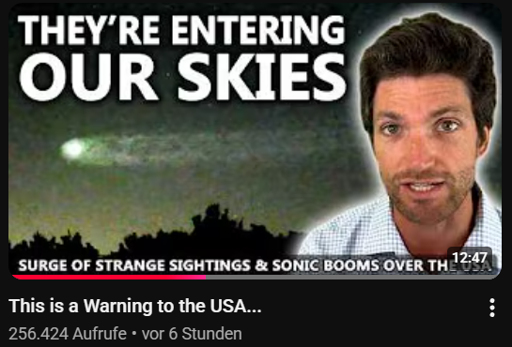
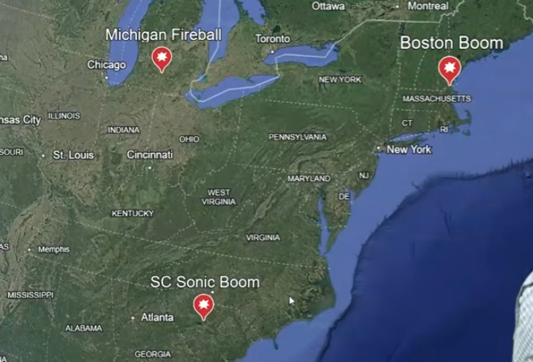
And the seventh angel poured out his vial into the air; and there came a great voice out of the temple of heaven, from the throne, saying, It is done. And there were voices, and thunders, and lightnings; and there was a great earthquake, such as was not since men were upon the earth, so mighty an earthquake, and so great. (Revelation 16:17-18)
https://www.youtube.com/watch?v=gR9cVV1kwT8&

Slide 17
And the seventh angel poured out his vial into the air; and there came a great voice out of the temple of heaven, from the throne, saying, It is done. And there were voices, and thunders, and lightnings; and there was a great earthquake, such as was not since men were upon the earth, so mighty an earthquake, and so great. (Revelation 16:17-18)

Slide 18
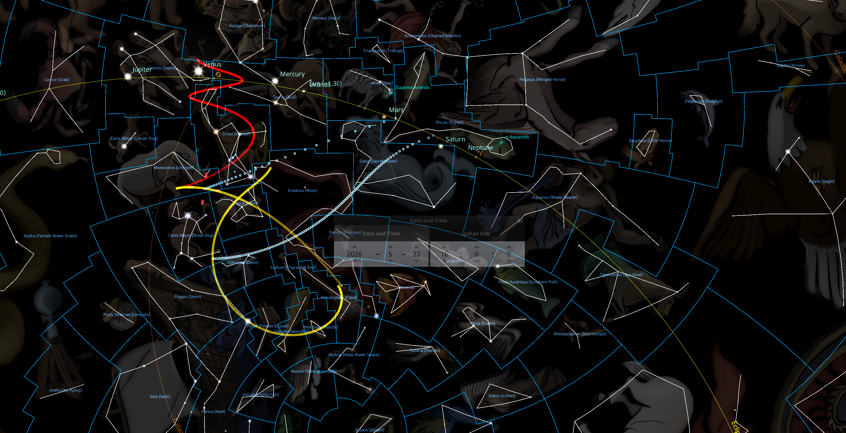
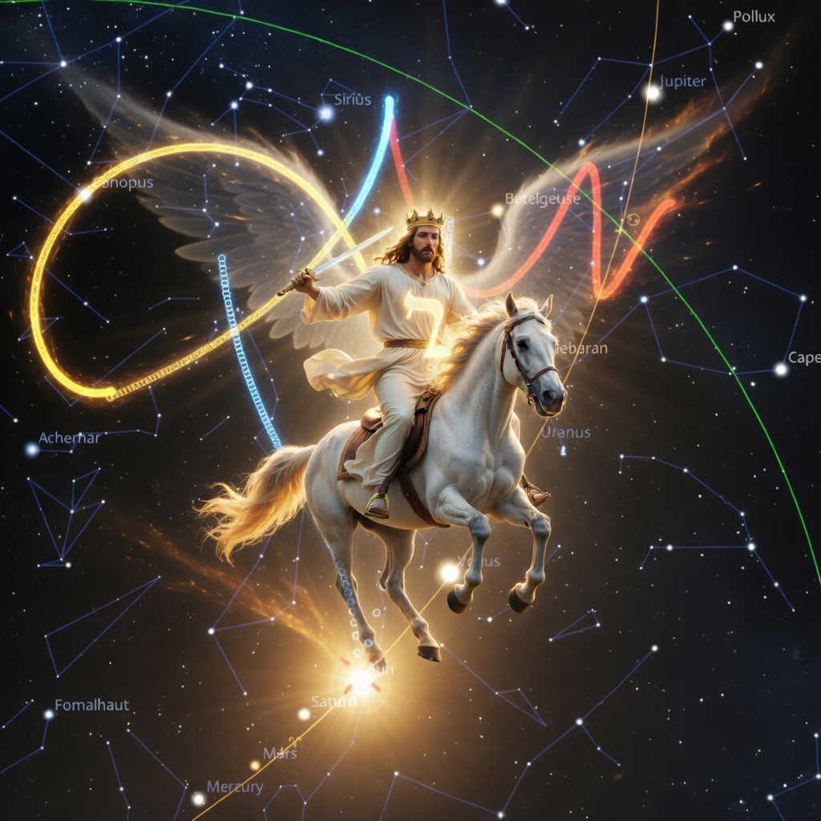
C/2025 R3
C/2017 K2
C/2026 A1
C/2022 E3
His eyes were as a flame of fire, and on his head were many crowns; and he had a name written, that no man knew, but he himself. (Revelation 19:12)
And the temple of God was opened in heaven, and there was seen in his temple the ark of his testament: and there were lightnings, and voices, and thunderings, and an earthquake, and great hail. (Revelation 11:19)

Slide 19
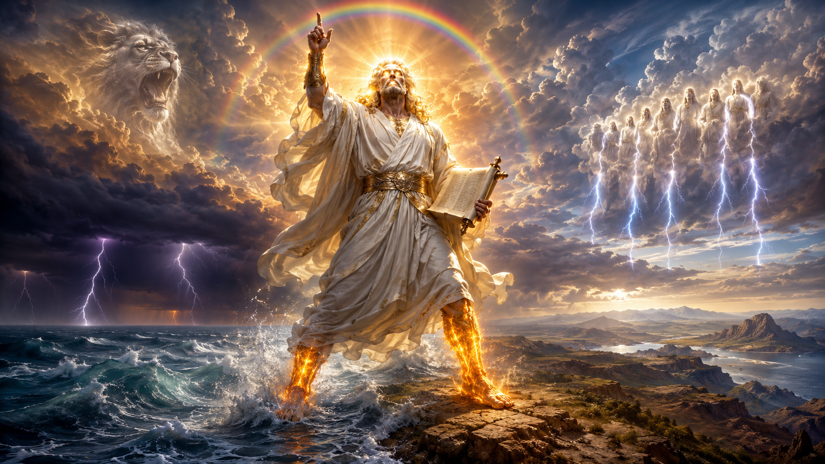
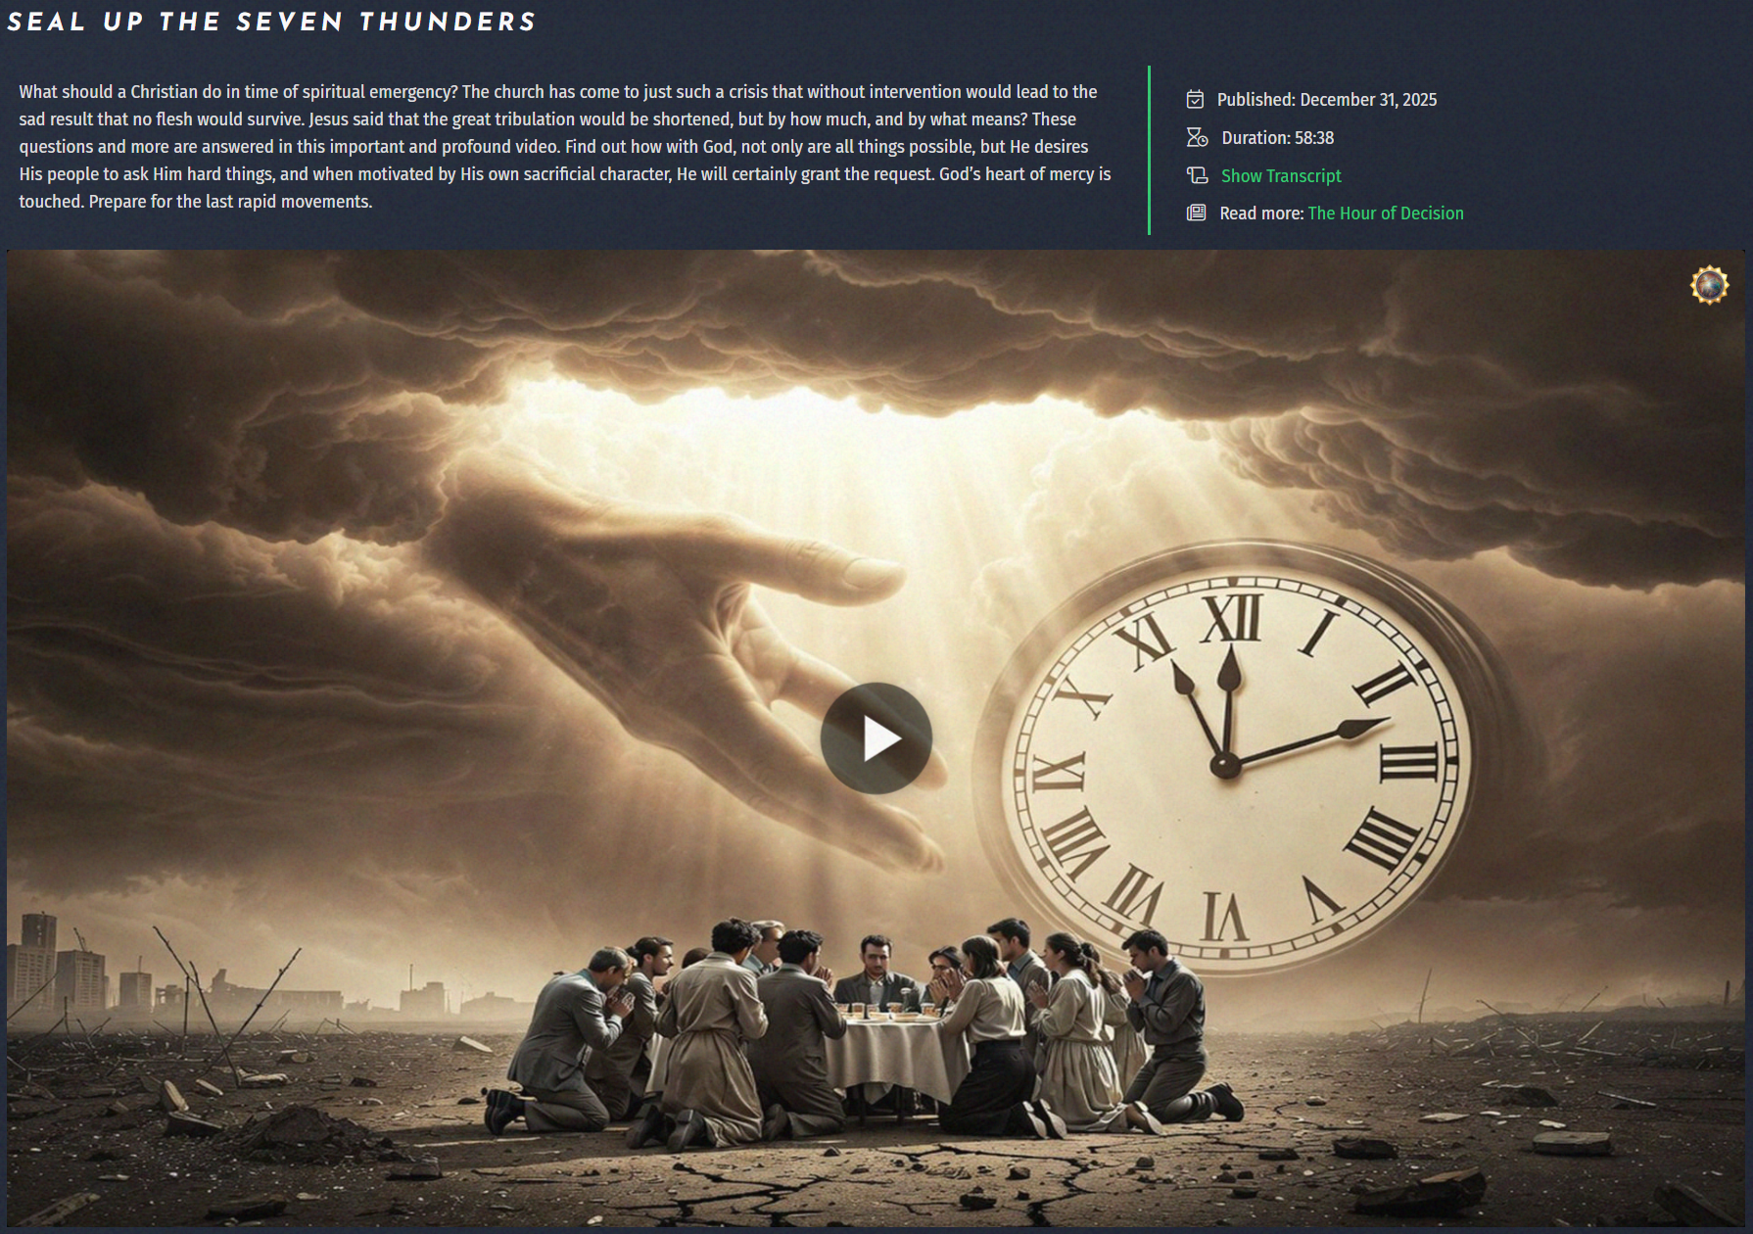

And I saw another mighty angel come down from heaven, clothed with a cloud: and a rainbow was upon his head, and his face was as it were the sun, and his feet as pillars of fire: And he had in his hand a little book open: and he set his right foot upon the sea, and his left foot on the earth, And cried with a loud voice, as when a lion roareth: and when he had cried, seven thunders uttered their voices. And when the seven thunders had uttered their voices, I was about to write: and I heard a voice from heaven saying unto me, Seal up those things which the seven thunders uttered, and write them not. (Revelation 10:1-4)

Slide 20
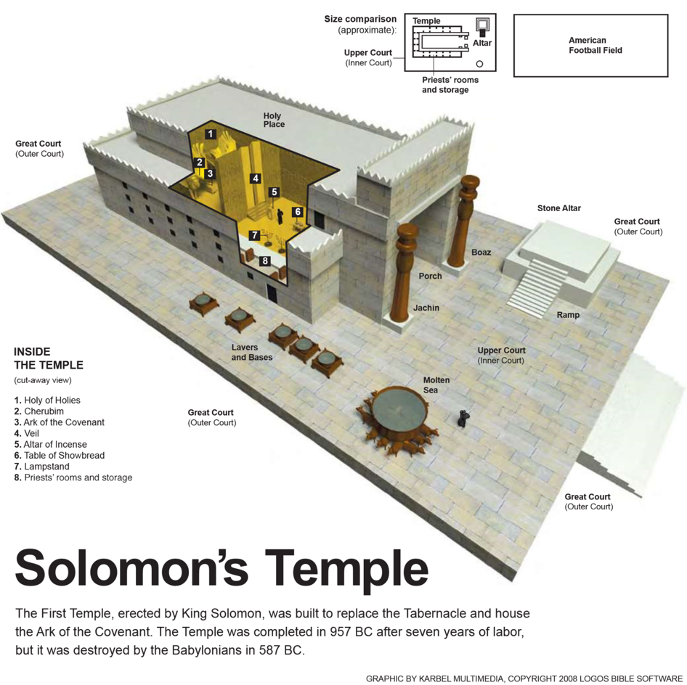
And the angel which I saw stand upon the sea and upon the earth lifted up his hand to heaven, And sware by him that liveth for ever and ever, who created heaven, and the things that therein are, and the earth, and the things that therein are, and the sea, and the things which are therein, that there should be time no longer: (Revelation 10:5-6)
The altar of burnt offering
The earth was the altar of sacrifice for Jesus!
He made also ten lavers, and put five on the right hand, and five on the left, to wash in them: such things as they offered for the burnt offering they washed in them; but the sea was for the priests to wash in. (2 Chronicles 4:6)
The sea

Slide 21
But in the days of the voice of the seventh angel, when he shall begin to sound, the mystery of God should be finished, as he hath declared to his servants the prophets. (Revelation 10:7)
John came in the spirit and power of Elijah to proclaim the first advent of Jesus. I was pointed down to the last days and saw that John represented those who should go forth in the spirit and power of Elijah to herald the day of wrath and the second advent of Jesus. EW 155.1

Slide 22
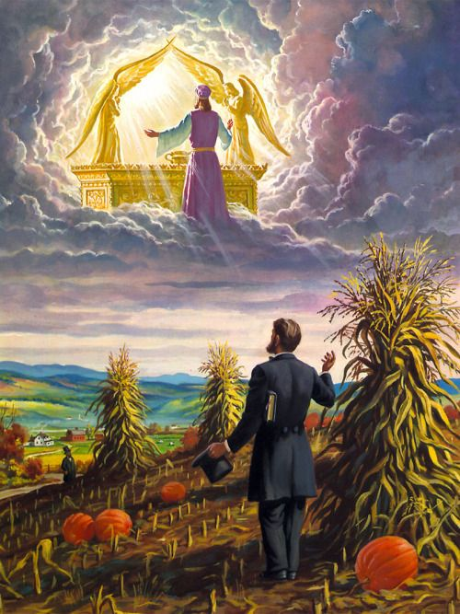
And the voice which I heard from heaven spake unto me again, and said, Go and take the little book which is open in the hand of the angel which standeth upon the sea and upon the earth. (Revelation 10:8)
And I went unto the angel, and said unto him, Give me the little book. And he said unto me, Take it, and eat it up; and it shall make thy belly bitter, but it shall be in thy mouth sweet as honey. And I took the little book out of the angel's hand, and ate it up; and it was in my mouth sweet as honey: and as soon as I had eaten it, my belly was bitter. And he said unto me, Thou must prophesy again before many peoples, and nations, and tongues, and kings. (Revelation 10:9-11)

Slide 23
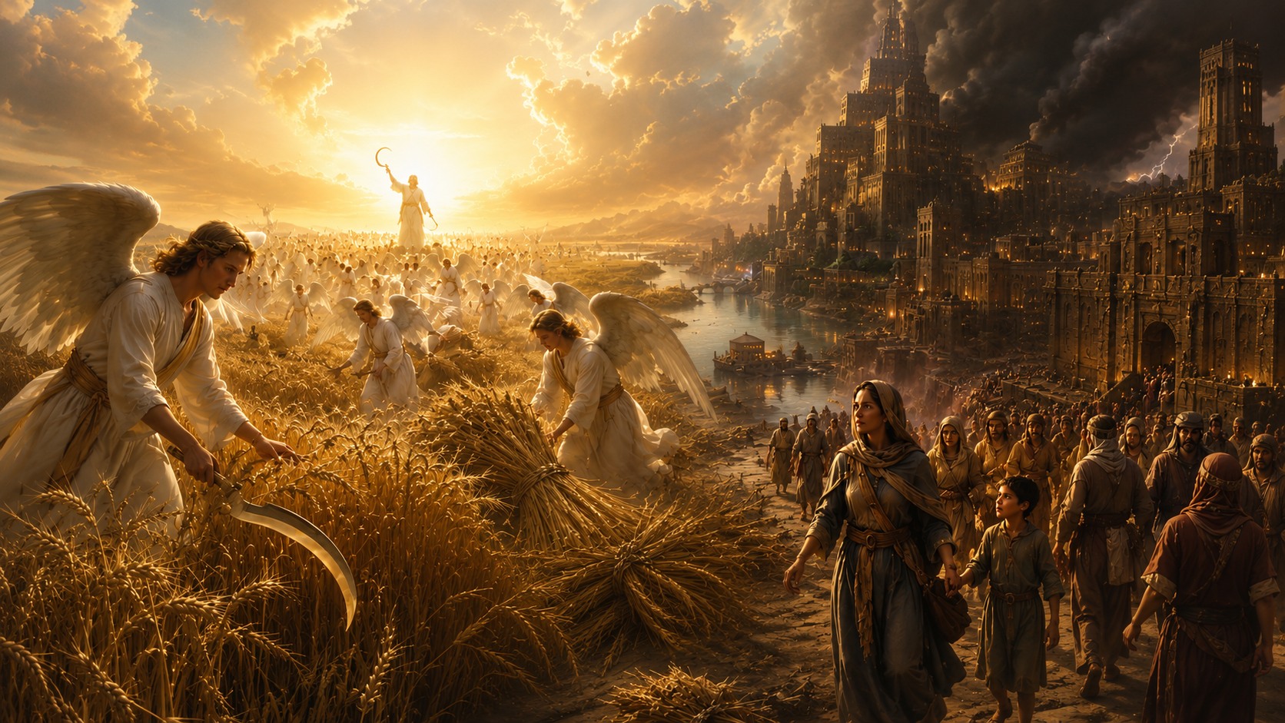
The Seventh Plague
We need to study the pouring out of the seventh vial [Revelation 16:17-21]. The powers of evil will not yield up the conflict without a struggle. But Providence has a part to act in the battle of Armageddon. When the earth is lighted with the glory of the angel of Revelation eighteen, the religious elements, good and evil, will awake from slumber, and the armies of the living God will take the field. LDE 251.3
And I heard another voice from heaven, saying, Come out of her, my people, that ye be not partakers of her sins, and that ye receive not of her plagues. For her sins have reached unto heaven, and God hath remembered her iniquities. (Revelation 18:4-5)

Slide 24
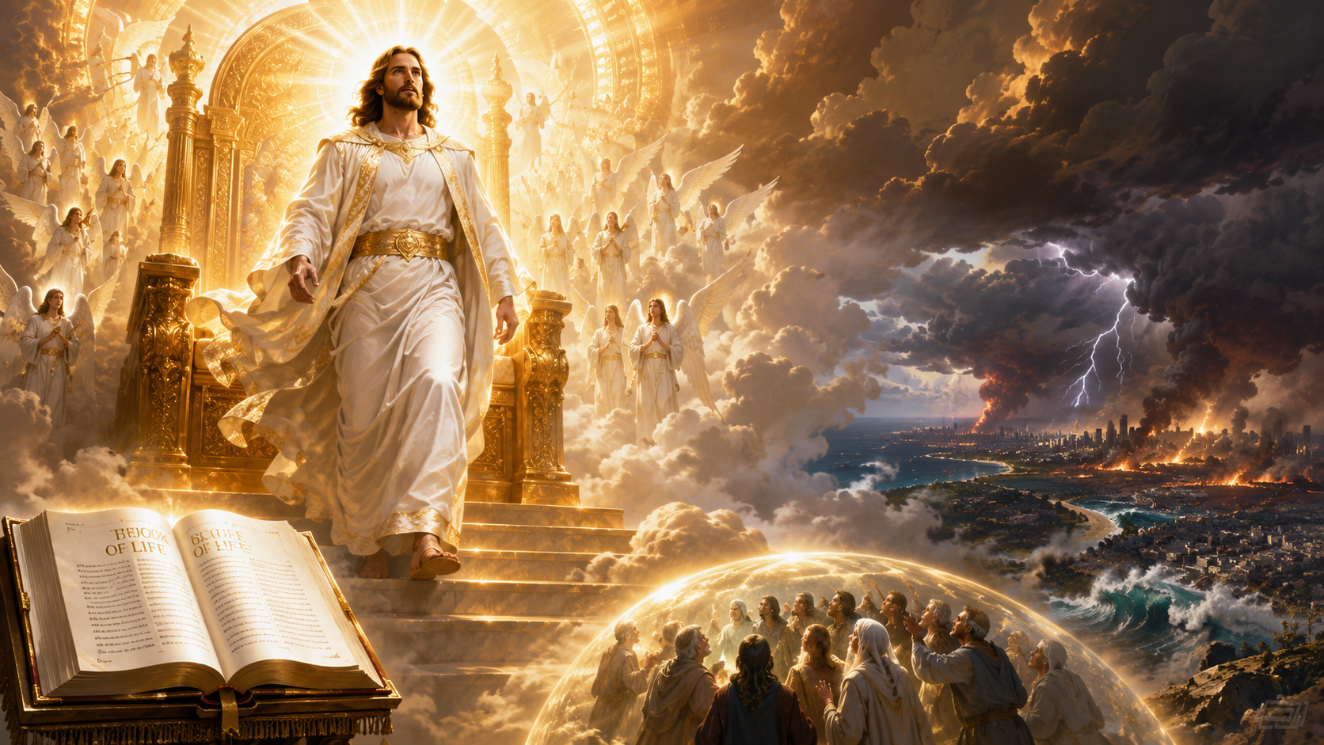
And at that time shall Michael stand up, the great prince which standeth for the children of thy people: and there shall be a time of trouble, such as never was since there was a nation even to that same time: and at that time thy people shall be delivered, every one that shall be found written in the book. (Daniel 12:1)

Slide 25
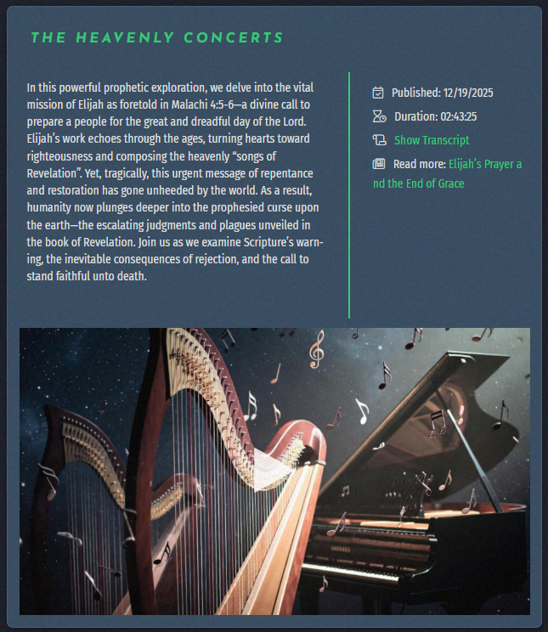

And they that be wise shall shine as the brightness of the firmament; and they that turn many to righteousness as the stars for ever and ever. (Daniel 12:3)
And I heard a voice from heaven, as the voice of many waters, and as the voice of a great thunder: and I heard the voice of harpers harping with their harps: And they [the 144,000] sung as it were a new song before the throne, and before the four beasts, and the elders: and no man could learn that song but the hundred and forty and four thousand, which were redeemed from the earth. (Revelation 14:2-3)

Slide 26
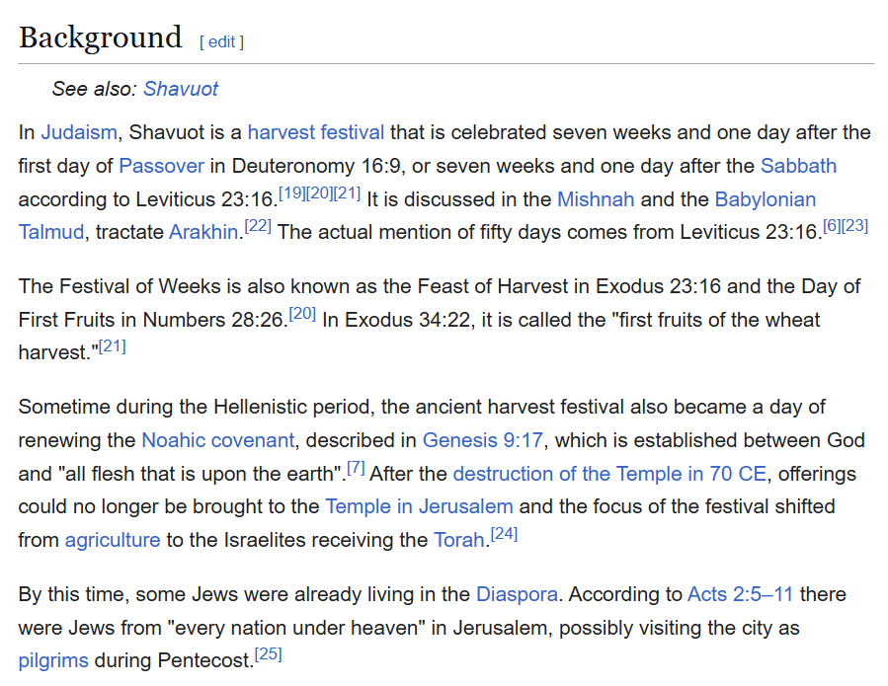
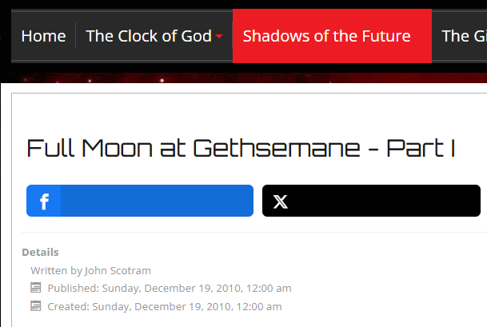
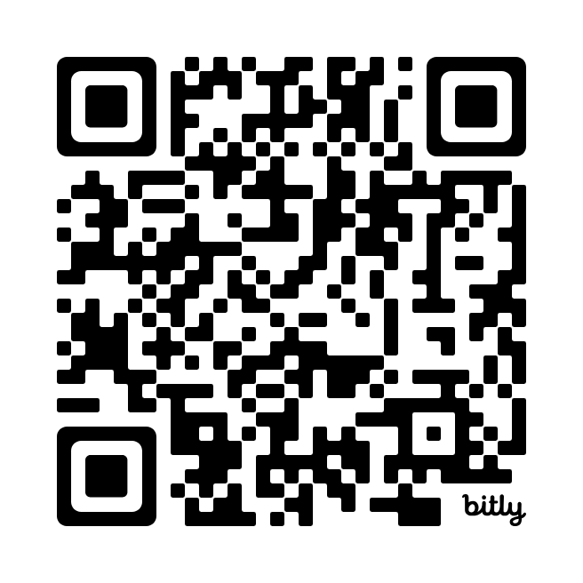
https://en.wikipedia.org/wiki/Pentecost

Slide 27
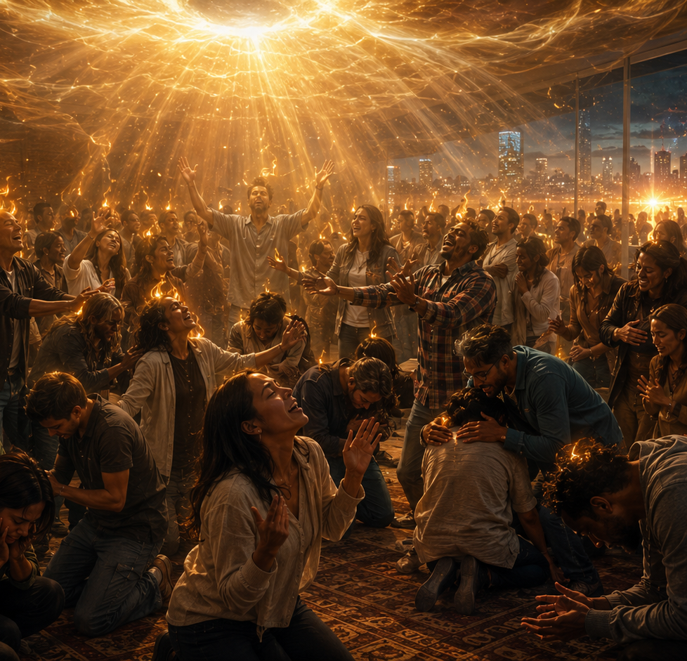
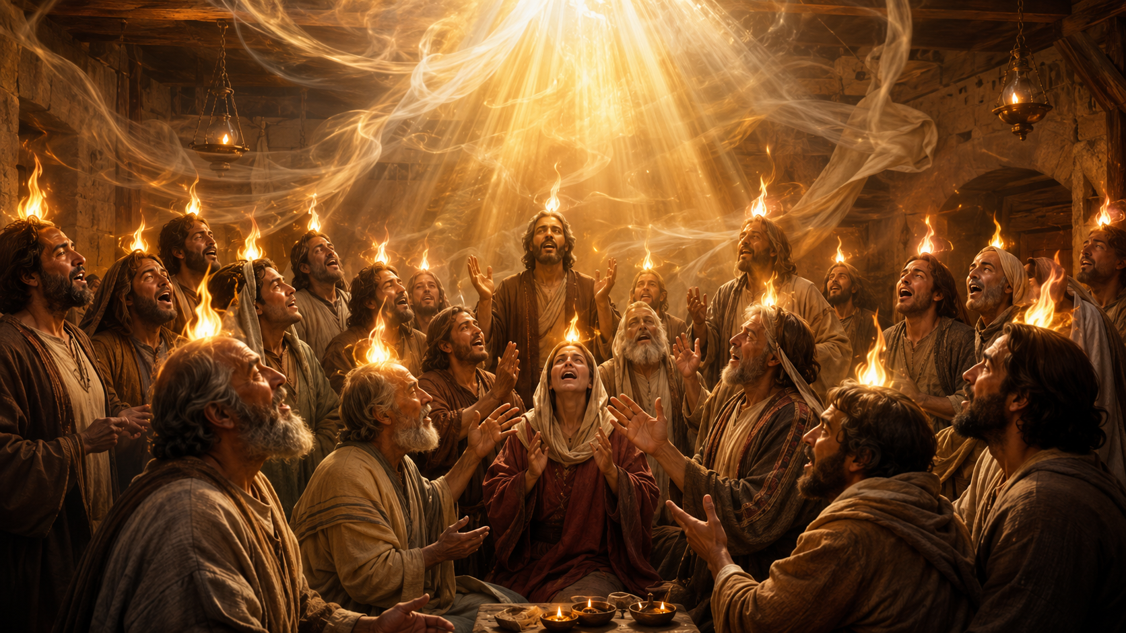
Early rain
31 AD
2026/27
Latter rain

Slide 28
Early rain
31 AD
The Work of the Spirit Likened to Rain
“He will cause to come down for you the rain, the former rain, and the latter rain.” In the East the former rain falls at the sowing time. It is necessary in order that the seed may germinate. Under the influence of the fertilizing showers the tender shoot springs up. The latter rain, falling near the close of the season, ripens the grain and prepares it for the sickle. The Lord employs these operations of nature to represent the work of the Holy Spirit.
As the dew and the rain are given first to cause the seed to germinate, and then to ripen the harvest, so the Holy Spirit is given to carry forward, from one stage to another, the process of spiritual growth. The ripening of the grain represents the completion of the work of God’s grace in the soul. By the power of the Holy Spirit the moral image of God is to be perfected in the character. We are to be wholly transformed into the likeness of Christ.
The latter rain, ripening earth’s harvest, represents the spiritual grace that prepares the church for the coming of the Son of man. But unless the former rain has fallen, there will be no life; the green blade will not spring up. Unless the early showers have done their work, the latter rain can bring no seed to perfection. LDE 183.1 to 183.3
2026/27
Latter rain

Slide 29
Early rain
31 AD
The Promise of the Latter Rain
The outpouring of the Spirit in the days of the apostles was “the former rain,” and glorious was the result. But the latter rain will be more abundant.
Near the close of earth’s harvest, a special bestowal of spiritual grace is promised to prepare the church for the coming of the Son of man. This outpouring of the Spirit is likened to the falling of the latter rain.
Before the final visitation of God’s judgments upon the earth there will be among the people of the Lord such a revival of primitive godliness as has not been witnessed since apostolic times. The Spirit and power of God will be poured out upon His children.
The work will be similar to that of the Day of Pentecost. As the “former rain” was given, in the outpouring of the Holy Spirit at the opening of the gospel, to cause the upspringing of the precious seed, so the “latter rain” will be given at its close for the ripening of the harvest. LDE 185.5-186.3
2026/27
Latter rain

Slide 30
The Loud Cry
I saw angels hurrying to and fro in heaven, descending to the earth, and again ascending to heaven, preparing for the fulfillment of some important event. Then I saw another mighty angel commissioned to descend to the earth, to unite his voice with the third angel, and give power and force to his message. Great power and glory were imparted to the angel, and as he descended, the earth was lightened with his glory. The light which attended this angel penetrated everywhere, as he cried mightily, with a strong voice, “Babylon the great is fallen, is fallen, and is become the habitation of devils, and the hold of every foul spirit, and a cage of every unclean and hateful bird.” The message of the fall of Babylon, as given by the second angel, is repeated, with the additional mention of the corruptions which have been entering the churches since 1844. The work of this angel comes in at the right time to join in the last great work of the third angel’s message as it swells to a loud cry. And the people of God are thus prepared to stand in the hour of temptation, which they are soon to meet. I saw a great light resting upon them, and they united to fearlessly proclaim the third angel’s message.
Angels were sent to aid the mighty angel from heaven, and I heard voices which seemed to sound everywhere, “Come out of her, My people, that ye be not partakers of her sins, and that ye receive not of her plagues. For her sins have reached unto heaven, and God hath remembered her iniquities.” This message seemed to be an addition to the third message, joining it as the midnight cry joined the second angel’s message in 1844. The glory of God rested upon the patient, waiting saints, and they fearlessly gave the last solemn warning, proclaiming the fall of Babylon and calling upon God’s people to come out of her that they might escape her fearful doom. EW 277.1 – 277.2
2026/27
Latter rain

Slide 31
The light that was shed upon the waiting ones penetrated everywhere, and those in the churches who had any light, who had not heard and rejected the three messages, obeyed the call and left the fallen churches. Many had come to years of accountability since these messages had been given, and the light shone upon them, and they were privileged to choose life or death. Some chose life and took their stand with those who were looking for their Lord and keeping all His commandments. The third message was to do its work; all were to be tested upon it, and the precious ones were to be called out from the religious bodies. A compelling power moved the honest, while the manifestation of the power of God brought a fear and restraint upon their unbelieving relatives and friends so that they dared not, neither had they the power to, hinder those who felt the work of the Spirit of God upon them. The last call was carried even to the poor slaves, and the pious among them poured forth their songs of rapturous joy at the prospect of their happy deliverance. Their masters could not check them; fear and astonishment kept them silent. Mighty miracles were wrought, the sick were healed, and signs and wonders followed the believers. God was in the work, and every saint, fearless of consequences, followed the convictions of his own conscience and united with those who were keeping all the commandments of God; and with power they sounded abroad the third message. I saw that this message will close with power and strength far exceeding the midnight cry.
Servants of God, endowed with power from on high with their faces lighted up, and shining with holy consecration, went forth to proclaim the message from heaven. Souls that were scattered all through the religious bodies answered to the call, and the precious were hurried out of the doomed churches, as Lot was hurried out of Sodom before her destruction. God’s people were strengthened by the excellent glory which rested upon them in rich abundance and prepared them to endure the hour of temptation. I heard everywhere a multitude of voices saying, “Here is the patience of the saints: here are they that keep the commandments of God, and the faith of Jesus.” EW 278.1 – 278.2
2026/27
Latter rain

Slide 32
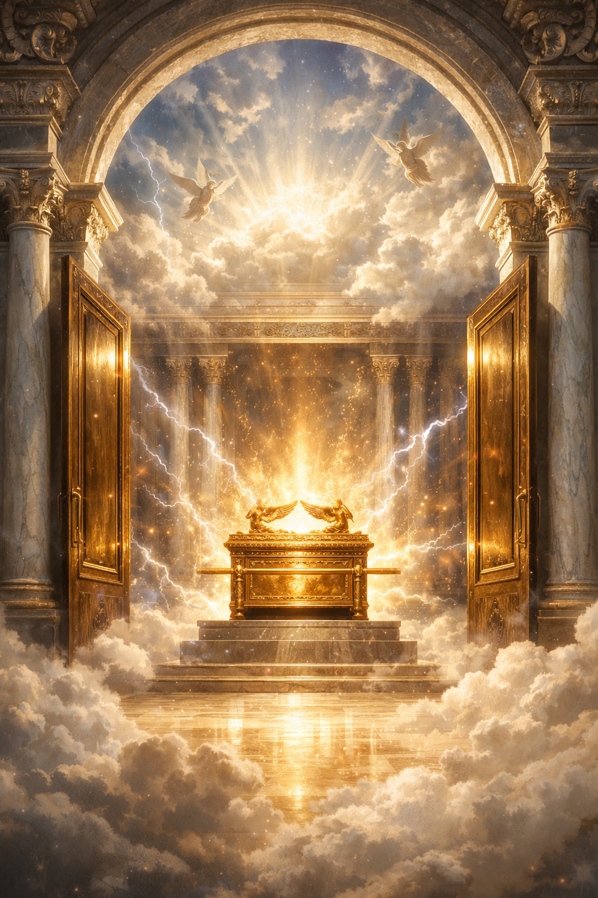

Fourth angel
And after these things I saw another angel come down from heaven, having great power; and the earth was lightened with his glory. And he cried mightily with a strong voice, saying, Babylon the great is fallen, is fallen, and is become the habitation of devils, and the hold of every foul spirit, and a cage of every unclean and hateful bird. For all nations have drunk of the wine of the wrath of her fornication, and the kings of the earth have committed fornication with her, and the merchants of the earth are waxed rich through the abundance of her delicacies. (Revelation 18:1-3)
The loud cry
Third angel
And the third angel followed them, saying with a loud voice, If any man worship the beast and his image, and receive his mark in his forehead, or in his hand, The same shall drink of the wine of the wrath of God, which is poured out without mixture into the cup of his indignation; and he shall be tormented with fire and brimstone in the presence of the holy angels, and in the presence of the Lamb: And the smoke of their torment ascendeth up for ever and ever: and they have no rest day nor night, who worship the beast and his image, and whosoever receiveth the mark of his name. Here is the patience of the saints: here are they that keep the commandments of God, and the faith of Jesus. (Revelation 14:9-12)
Jesus Himself counsels:
And I heard another voice from heaven, saying, Come out of her, my people, that ye be not partakers of her sins, and that ye receive not of her plagues. For her sins have reached unto heaven, and God hath remembered her iniquities. (Revelation 18:4-5)

Slide 33
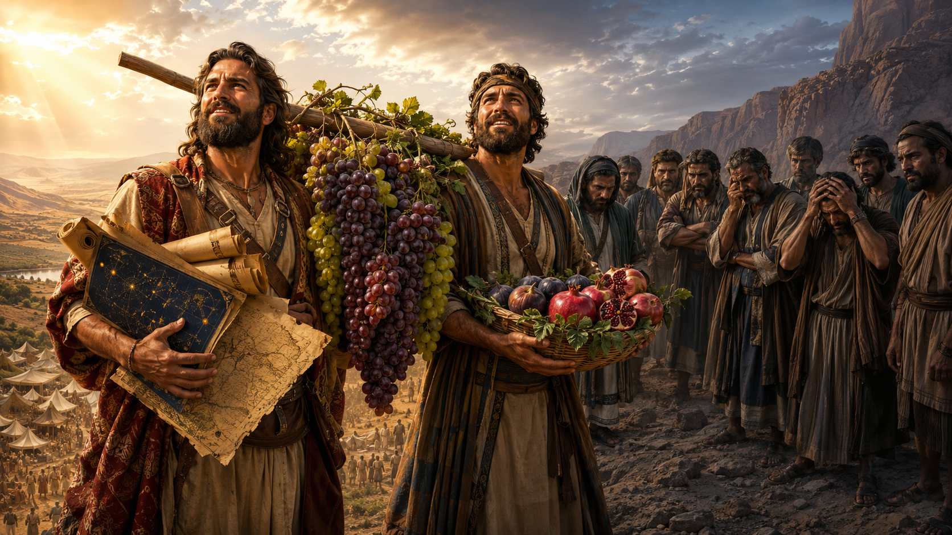
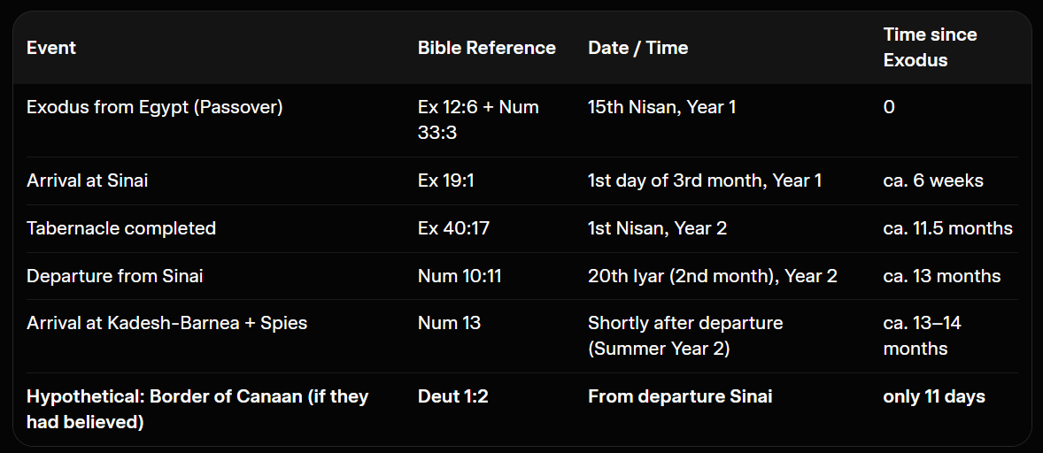
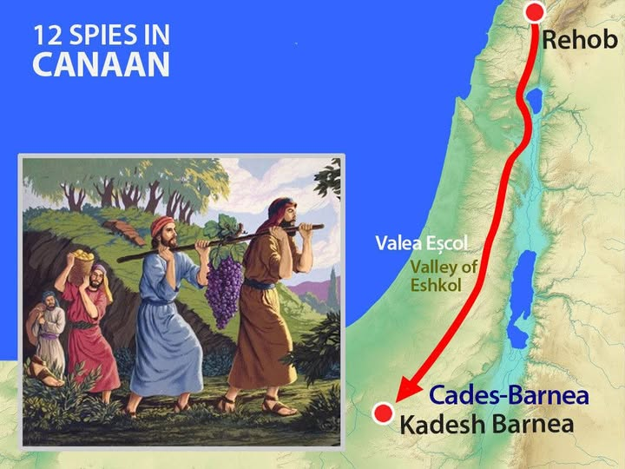
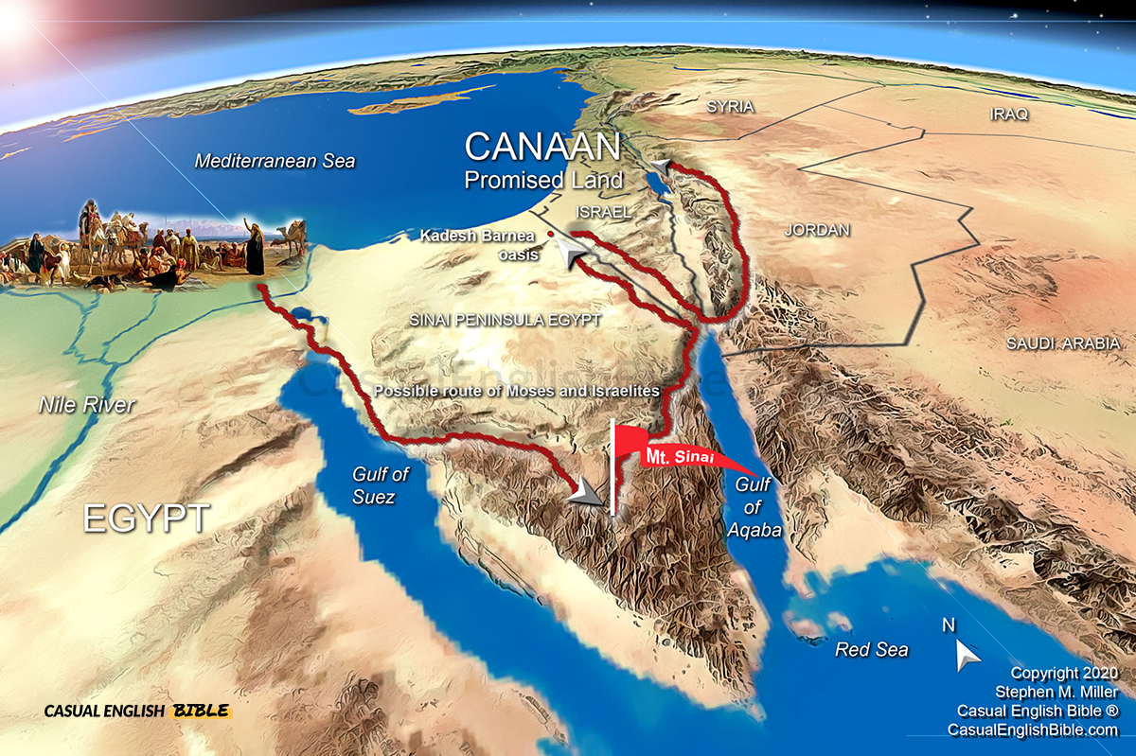

Slide 34
These are the two olive trees, and the two candlesticks standing before the God of the earth. (Revelation 11:4)

